Slide 1
CS 321 Group 3 Presentation
Anjan N, Matthew J, Matthew L, Anthony M

Slide 2
Project Description
Online order service for Panera Bread
Keeps track of quantity of each item and total price
Able to choose food, delivery type, enter payment type
Employee can see information in the form of a ticket
Manager can see both customer view and employee view

Slide 3
Uses Cases
Login screen to show the different users types such as customer, employee, and manager
Begin the order, where the user browses through the food menu
Then the user can add the item to the cart
Looped until the user does not want to add any more items
User chooses the delivery type of either delivery or pickup
Payment information from the user so that the order can be confirmed so employees can start making the order
Last use case is updating the ticket
As each food item is being prepared, the ticket is being updated
Looped until last item on the ticket in which the order is complete

Slide 4
Use Case #1 - Customer
The customer visits the Pantera website to order food.
The customer logs in with username and password.
Username:
Password:
Customer is able to add food items
Customer then click Finalize Cart button when done ordering
Customer is then taken to the Delivery Menu screen.
Pickup
Delivery
The customer is then taken to the payment screen.
The customer is asked to enter information.
CCNUM
CVC
EXP
ZIP
Order is placed

Slide 5
Use Case #1 - Customer… continued
Variation #1
1.1 Customer enters invalid username and password.
1.2 The website displays information.
Sign In Denied
1.3 Customer is returned to login screen.
Variation #2
2.1 At Step 5, if the customer chooses Delivery, he will be asked for his address for the location of where the food should be delivered
Variation #3
3.1 Customer enters invalid credit card information
3.2 Given two options of canceling order or re-entering credit card information

Slide 6
Use Case #2 - Employee
The employee visits the website the view the Current Ticket
Employees can change the status of the Current Ticket by acknowledging that the food is ready.
Once the Current Ticket is done, the employee logs out and then logs in to view the next ticket in the queue.
Variations:
1.1 If the order type is delivery, once the food is prepared, the status will change to “Order Delivery in Progress”, wait 5 seconds, then change to “Food is Delivered”

Slide 7
Use Case #3 - Manager
The manager visits the website to view the current Order Queue.
The manager can view the Tickets in the OrderQueue.
The manager can logout when they are done.

Slide 8
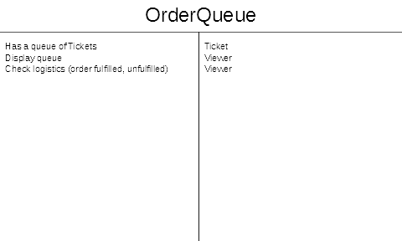
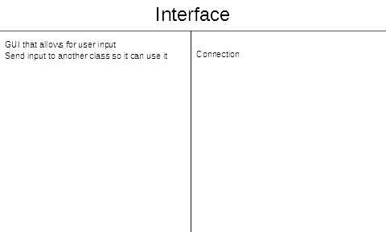
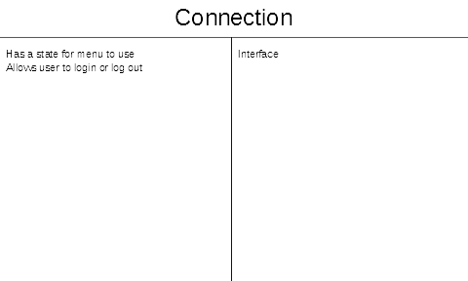
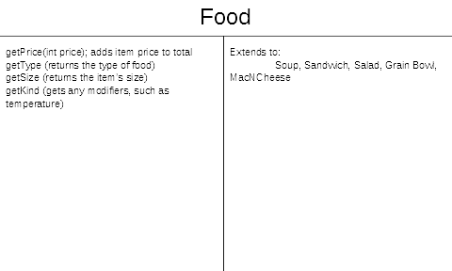
CRC Cards

Slide 9
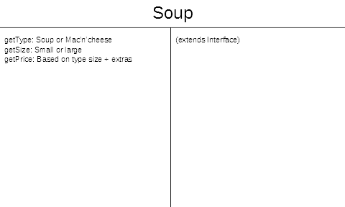
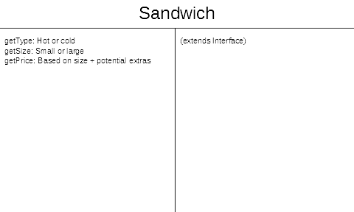
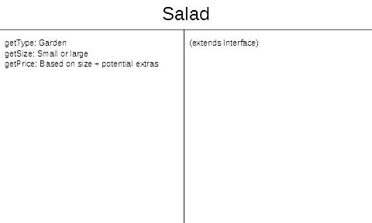
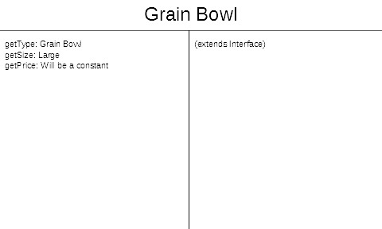
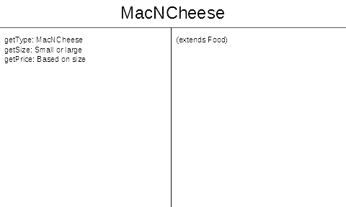
CRC Cards

Slide 10
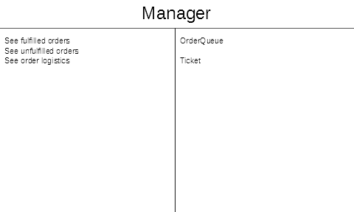
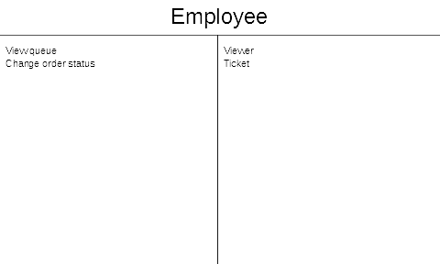
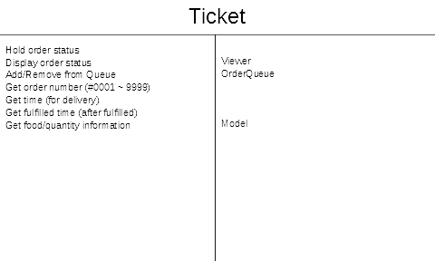
CRC Cards

Slide 11
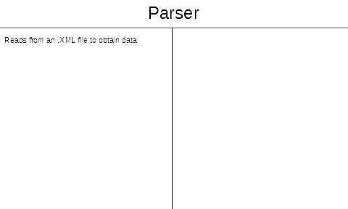
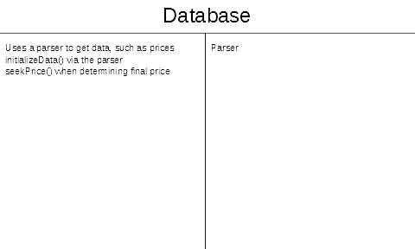
CRC Cards

Slide 12
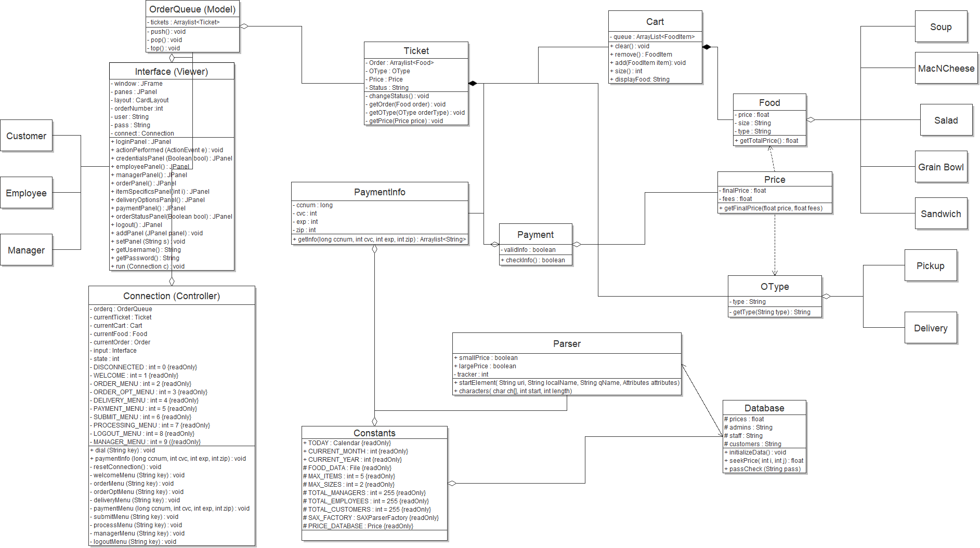
Class Diagram

Slide 13
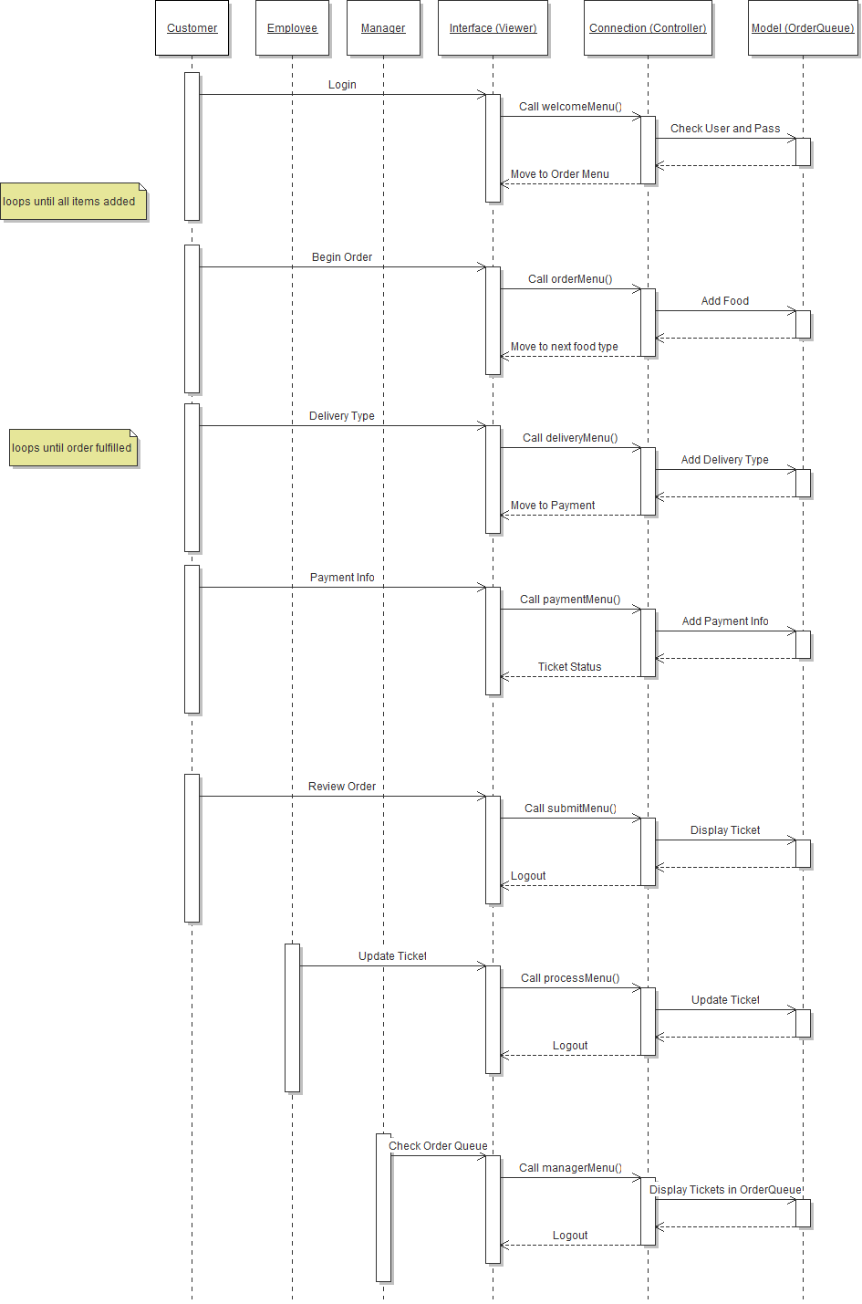
Sequence Diagram

Slide 14

Sequence Diagram

Slide 15
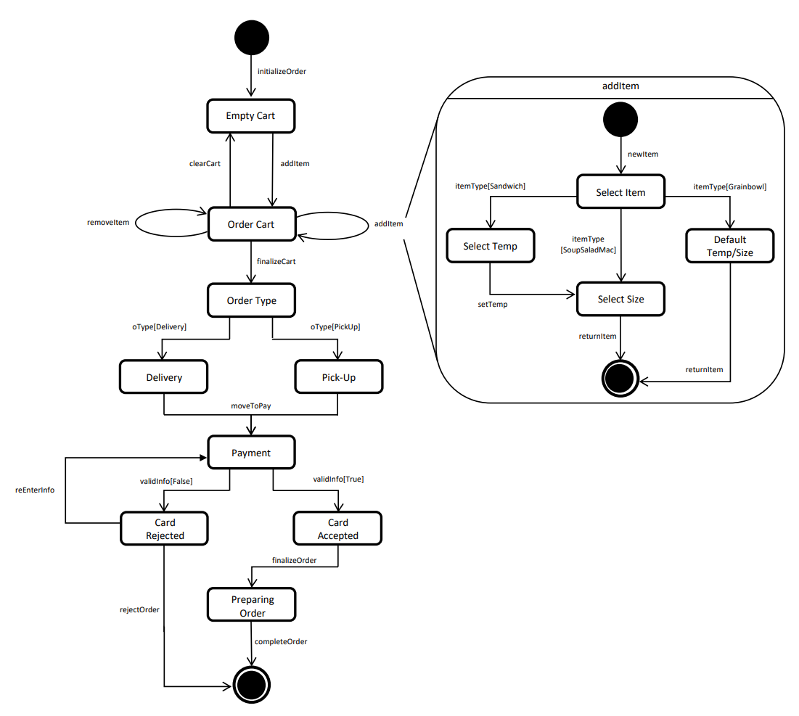
State Diagram

Slide 16
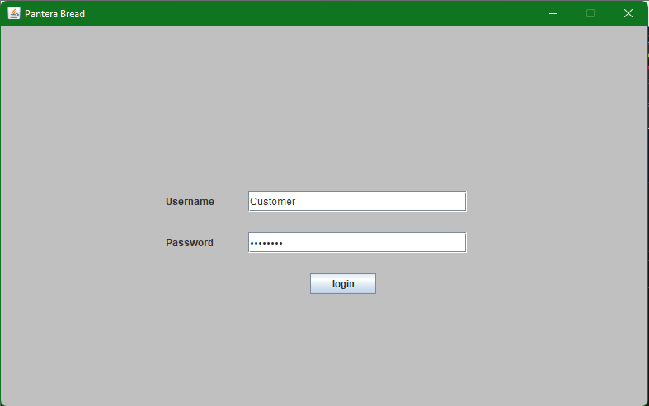
Testing - Login Screen Test

Slide 17
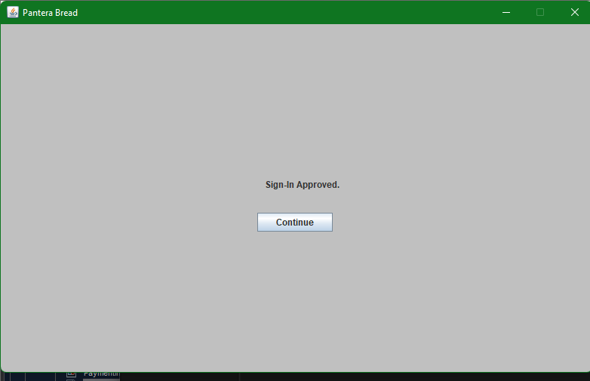
Testing - Login Screen Test… continued

Slide 18
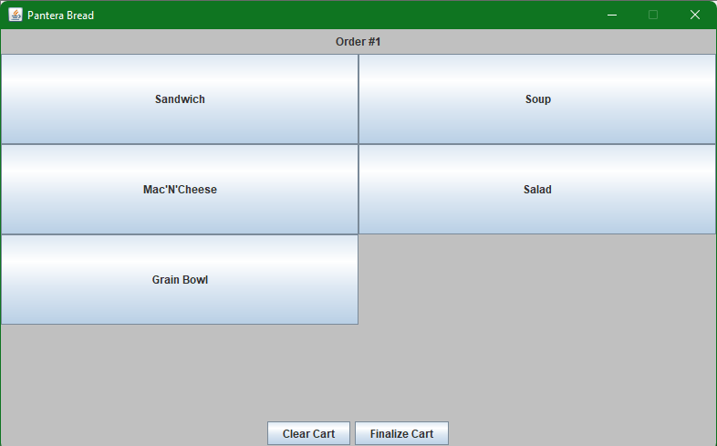
Testing - Order Menu Test

Slide 19

Testing - Order Options Menu

Slide 20
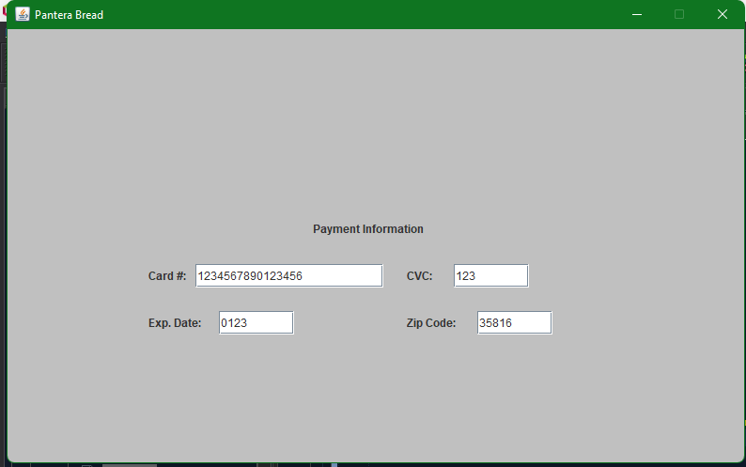
Testing - Payment Menu

Slide 21
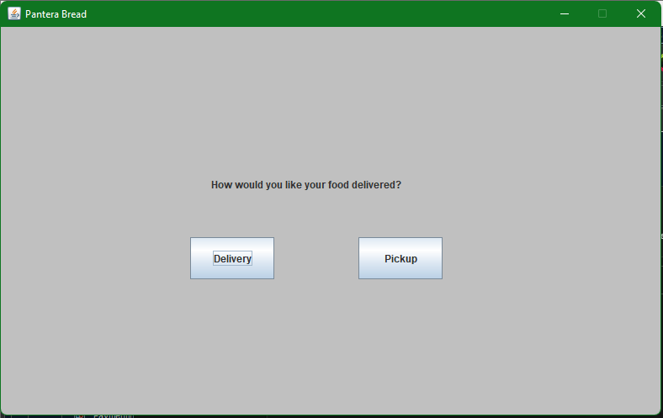
Testing - Delivery Menu

Slide 22
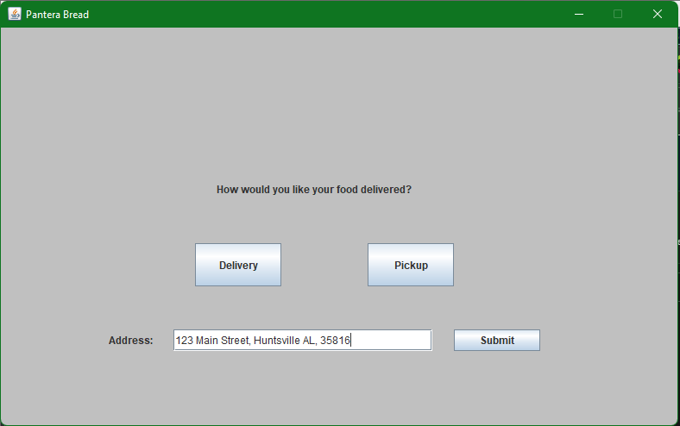
Testing - Delivery Address Menu

Slide 23
Design Choices
Food and Order Types were created with a Java Interface
Food Interface contains Sandwich, Salad, etc. while OType Interface contains Pickup and Delivery
Code Encapsulation
Interface class (Viewer) exclusively grabs from Connection (Controller) while the connection uses functions from OrderQueue (Model) and its related classes
if something were to fail in one of the food classes, it would not cause issues with the interface
Cloning
New Tickets, Payments, Carts, etcs are made using the new function in Java
This prevents explicit code from being used, making final variables more secure, as they cannot be changed from a driver

Slide 24
Design Patterns
Observer:
The Interface class would be the Observer pattern as it is pays attention to user input into the GUI
Composite:
Sandwich, Salad, Soup, MacNCheese, and GrainBowl are grouped into a whole as FoodItem
Delivery and Pickup are grouped together as OType
Strategy:
The calculation of the total price from the Cart and the Order Type is wrapped into the Price class
Iterator:
Interface only uses the Connection while Connection uses all of the other classes

